Slide 1
Construction Site Hazard Detection
24.678: Computer Vision for Engineers
TEAM BANGALORE
Peter Blumenstein
Nikhil Chinnalapatti Gopinath
David Ologan
Arpit Sahni
Notes:
enhance safety
improve productivity
help bottom line

Slide 2

Problem
10.2/
100,000
$5B
Worker Fatality
Rate
Industry
Total
1.1%
$1M
Worker Injury
Rate
Company Cost
Per Fatality
Notes:
2020: 1000 workers died
$5B: hospital costs, productivity losses, future earnings lost,
company emphasizes safety - work to reduce
https://www.bls.gov/web/osh/summ1_00.htm#soii_n17_as_t1.f.1
https://www.bls.gov/charts/census-of-fatal-occupational-injuries/number-and-rate-of-fatal-work-injuries-by-industry.htm
https://midwestepi.files.wordpress.com/2017/05/mepi-construction-fatalities-nationwide-final.pdf

Slide 3

Our Proposal
Productivity
Workers’ satisfaction
Identify hazards on work sites
Track worker proximity
Alert workers who within dangerous limits
Injury & Fatality Rates
Workers Comp. Premiums
Notes:
half of injuries are fall/struck-by incidents
Existing use ML, estimated geometry
build on that - custom zones
uniqueness of sites
safety rating allows more bids

Slide 4

Budget
Cost of Implementation of Lidar
Cost of Implementation of CCTV
$23,000
$7,000
Notes:
only need a camera
magnitude cheaper
already have cameras budgeted/installed

Slide 5

Our Method
Preprocess site
Read video stream
Apply YOLO
Map positions
Output video
Notes:
David

Slide 6

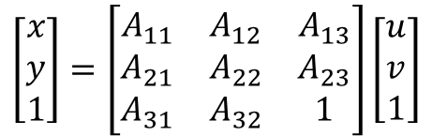
Preprocessing the Site
Fixed Camera
4 Known Positions
Coordinate Transform Matrix
Notes:
This works because we assume that the workers’ feet are always on the same plane, which means z=0 all the time. (x,y) are world coordinates. (u,v) are pixel values
David

Slide 7
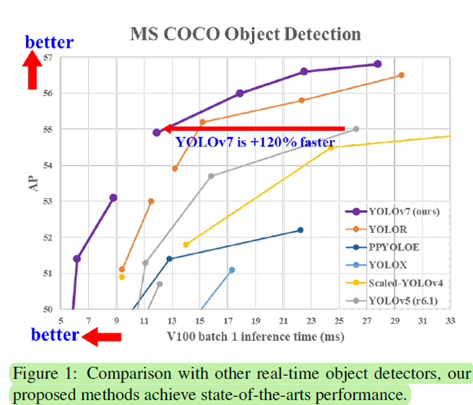
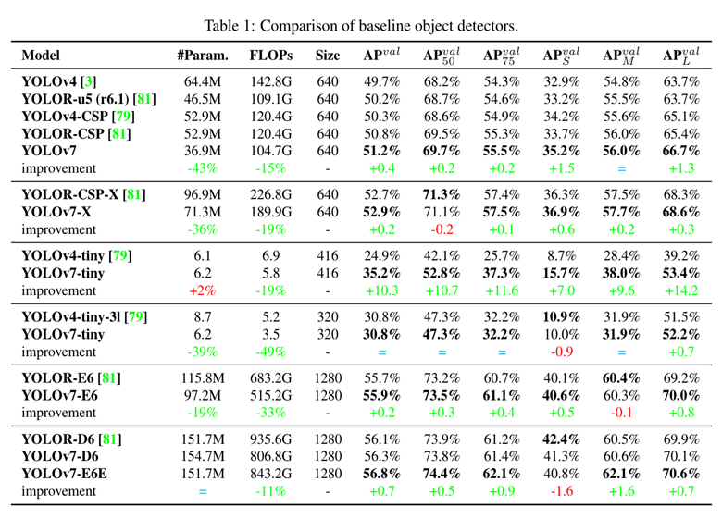
YOLOV7
Outperforms all transformer based and convolutional neural network based detectors in range of 5FPS and 160FPS.
YOLOv7 has the highest AP OF 56.8% of among real-time object detectors.
75% fewer parameters than previous Bag of freebies model( yolov4)

Slide 8
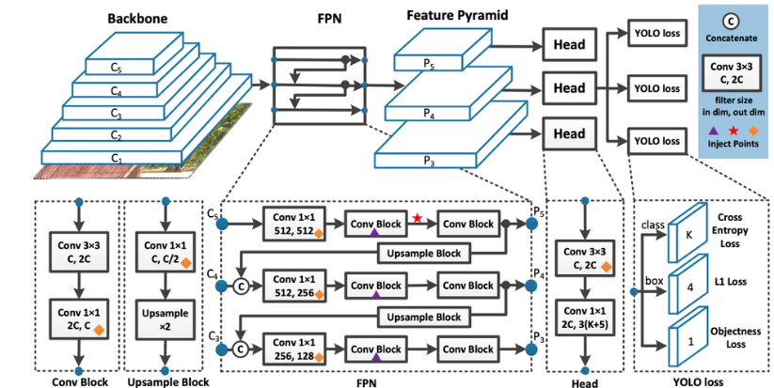
YOLOV7
MS COCO Dataset to train the Model.
Backbone is composed of Convolution Layers that extracts features using improved Pretrained Model E-LAN weights.
The Neck Collects feature maps from different stages and predicts the bounding box coordinates and classification probabilities.

Slide 9
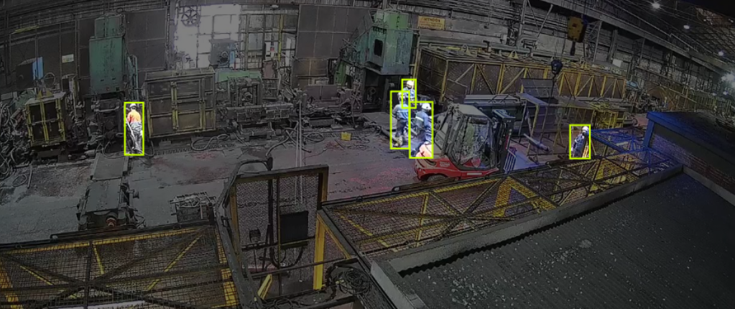
Transfer Learning
Take Final layers from a model trained previously on COCO dataset.
Freeze all layers except Last Few.
Exploit previous Low level feature detection capability and then combine it with higher level features learned with new dataset(Construction Worker Dataset).
Example Image with annotations from the Construction Worker Dataset

Slide 10
Fine Tuning and Improvements
Metrics | Base-line | Improved
Precision | 0.697 | 0.81
Recall | 0.497 | 0.80
mAP@0.5 | 0.60 | 0.78
Notes:
AP (Average Precision) is a metric that combines precision and recall.
Precision measures the fraction of positive predictions that are correct, while recall measures the fraction of actual positive cases that were correctly predicted.
Recall
What proportion of actual positives was identified correctly
TP/TP+FN
Precision
What proportion of positive identifications was actually correct
TP/TP+FP

Slide 11
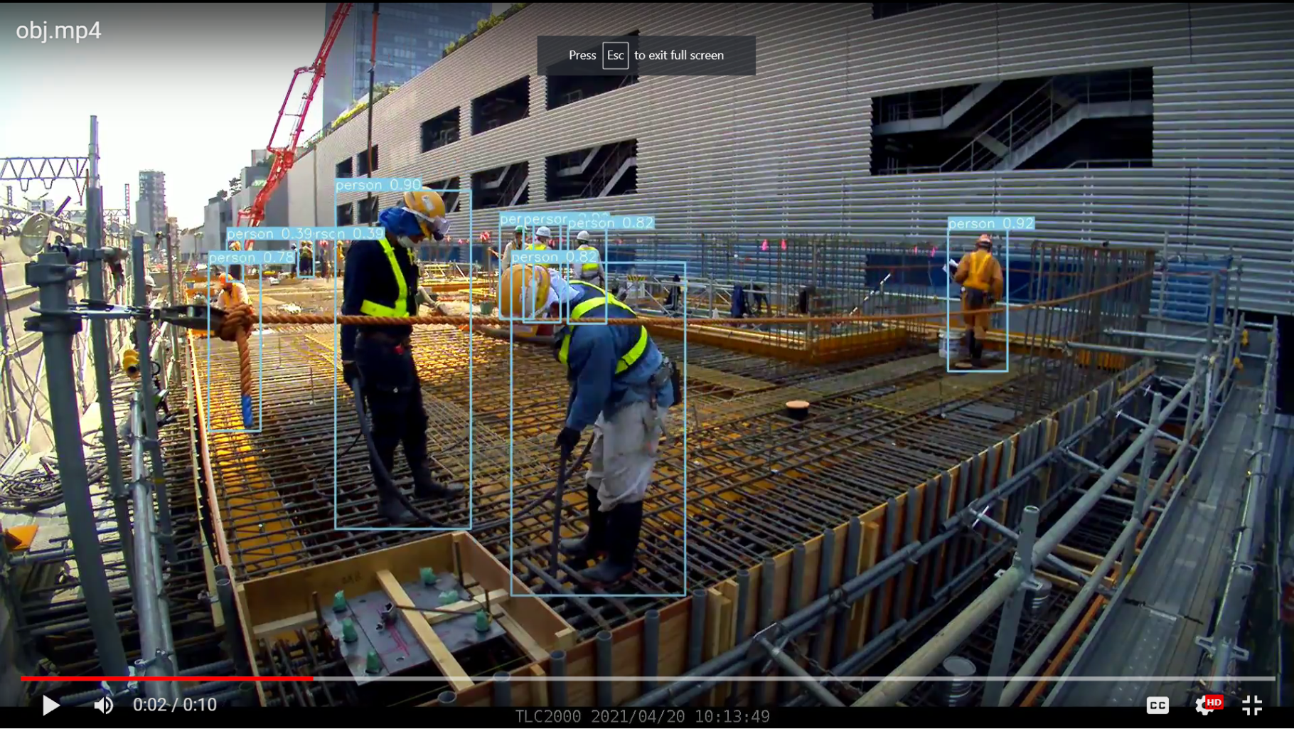
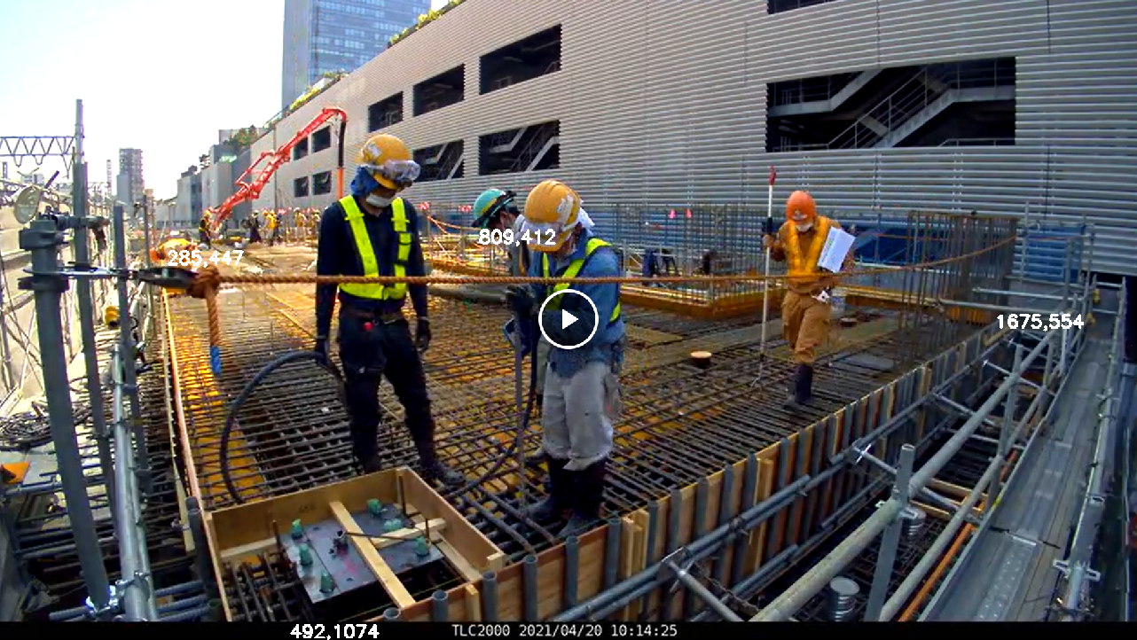
Mapping Positions
YOLO outputs pixel values for the center of the bounding box, and the dimensions of the box itself
Calculate position by averaging the bottom of the bounding box
Transform those pixel values into world coordinates using the matrix formed when preprocessing the site
Notes:
David

Slide 12
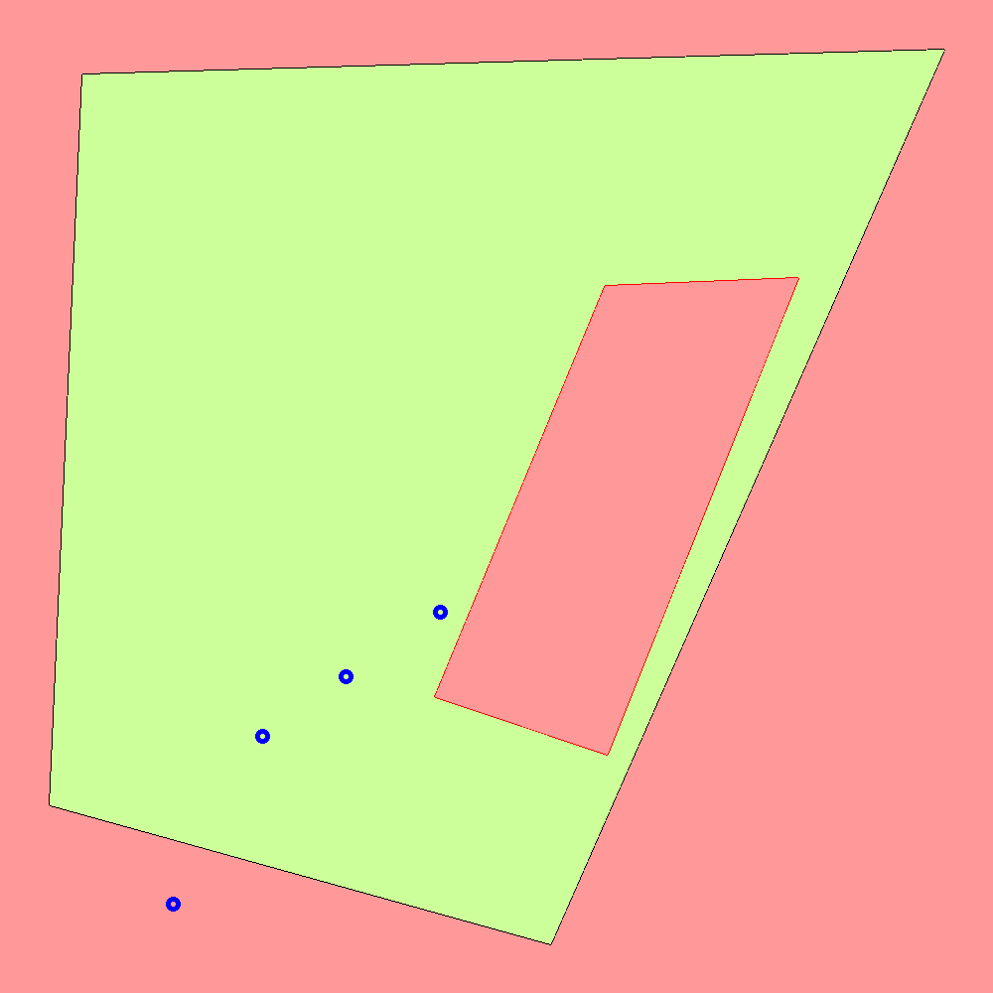

Generating Outputs
To generate an output video mapping worker positions:
  Scale the worker world coordinates to pixel coordinates by the size of each frame and the length of our boundary
Combine each individual frame of the output video to create an animation
Given the predefined hazard areas, we can classify workers in danger
Frame at t = t
Frame at t = t+1
Notes:
David

Slide 13
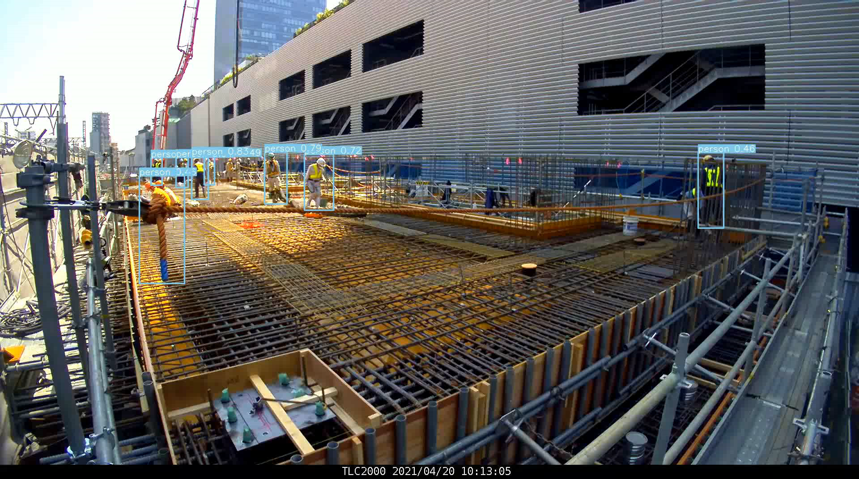
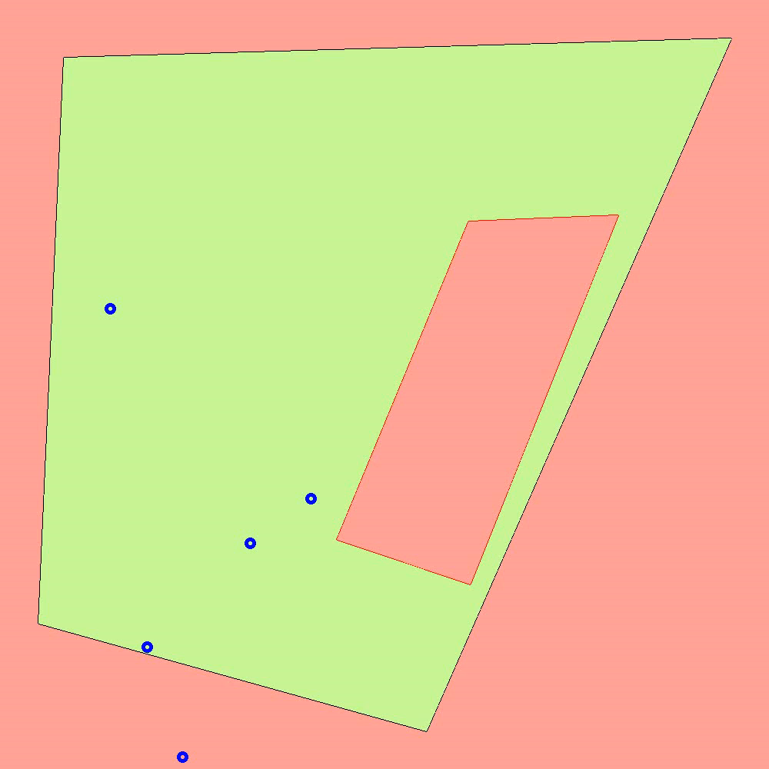
Results

Slide 14
Product Capabilities
Identify workers and draw bounding boxes around them
Defines the boundaries and hazardous zones in the construction sites
Transforms the workers positions into coordinate system of the construction site.
Identifies the workers that are outside of the safe and raises a warning on crossing

Slide 15
Product Limitations
Model cannot fully handle occlusions, fails to identify construction workers in some cases
  Could possibly be resolved by merging multiple camera angles
Model requires manual selection of the boundary points and the hazardous zones
  Can be done automatically with input of the floor plan
Can only identify workers it the camera feed
  Should identify hazardous equipment and the dangers of that

Slide 16
Why our Product?
Pre-existing solutions require specialized equipment like LIDAR
Our product uses RGB camera (cheap and accessible), already present in CCTV systems
We guarantee accurate and fast Detection and processing.
Not too computational intensive. Can be deployed on mobile architectures.

Slide 17

Future Scope
Implementation of detection of other hazards in the workspace
Incorporation of floor plans to automatically detect the boundaries and hazardous zones
Stitching multiple cameras into the input to prevent occlusion and more accurate estimation of the depth and position of the worker.
Better object detection model and training dataset to detect workers more accurately, and the other things in a construction site

Slide 18
Thank You
Any Questions

